Slide 1


Programming Language Translation: Regex and EBNF
Grammar representation for parsing and compiler design
Notes:
Image source: AI-generated

Slide 2

Agenda
• Overview of Programming Language Translation
• Introduction to Regular Expressions
• Using Regular Expressions in Lexical Analysis
• Introduction to EBNF (Extended Backus-Naur Form)
• Linking Regular Expressions and EBNF in Language Translation
Notes:
Overview of Programming Language Translation Introduction to Regular Expressions Using Regular Expressions in Lexical Analysis Introduction to EBNF (Extended Backus-Naur Form) Linking Regular Expressions and EBNF in Language Translation Image source: AI-generated

Slide 3

Overview of Programming Language Translation
Notes:
Purpose and Importance of Translation in Programming Languages, The Role of Syntax and Grammar in Translation, Basic Translation Workflow (Lexical Analysis, Parsing, Etc.)

Slide 4
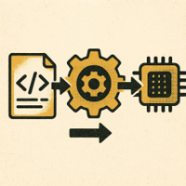
Purpose of Translation in Programming
From Human Logic to Machine Code
Translators convert readable algorithms into executable instructions across platforms.
Compilers and Interpreters
They bridge semantics to operations, enabling productivity and rapid iteration.
Optimization and Portability
Translation improves performance and memory use while keeping code hardware‑independent.
Notes:
Programming language translation is fundamental for converting human-readable code into machine-executable instructions, enabling software development across different platforms. It allows high-level languages to be hardware-independent and supports optimization for performance and memory usage. Translators such as compilers and interpreters serve to bridge the semantic gap between human logic and machine operations, enhancing productivity and enabling complex applications. Image source: AI-generated

Slide 5

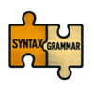



The Role of Syntax and Grammar in Translation
Strengths
Syntax and grammar enforce code structure, ensuring clarity and consistency in translation. They help maintain language standards and reduce ambiguity.
Weaknesses
Strict syntax rules can limit flexibility and make translation sensitive to minor errors, potentially increasing complexity for developers.
Opportunities
Advanced grammar models can improve automated translation accuracy and enable better error recovery strategies, enhancing reliability.
Challenges
Handling edge cases and ambiguous constructs remains difficult, requiring robust error detection and recovery mechanisms during compilation.
Notes:
Syntax and grammar define the structure and valid arrangements of symbols in a programming language; they are essential for the translator to understand and verify code correctness. Formal grammar representations ensure that source code conforms to language specifications, preventing ambiguous interpretations. Syntax rules also facilitate error detection and recovery during compilation, improving reliability and debugging. Image source: AI-generated

Slide 6
Basic Translation Workflow
01
Lexical Analysis
Tokenize source using patterns to isolate meaningful symbols.
02
Parsing
Build syntax trees from tokens using the language grammar.
03
Semantic Analysis
Validate types, scopes, and rules to ensure meaningful programs.
04
Optimization
Refine intermediate code to run faster and use fewer resources.
05
Code Generation
Emit target instructions and layout for executable output.
Notes:
Translation typically progresses through stages: lexical analysis isolates tokens using pattern matching; parsing assembles tokens into syntax trees based on grammar; semantic analysis validates meaning; optimization improves efficiency; code generation outputs target executable code. Each phase is crucial for transforming raw code into a machine-readable format effectively. Understanding this workflow is key for designing robust translators.

Slide 7
Introduction to Regular Expressions
Notes:
Definition and Motivation for Regular Expressions, Syntax and Basic Constructs (Literals, Concatenation, Alternation, Repetition), Examples of Regular Expressions in Describing Tokens

Slide 8
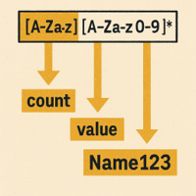
Regular Expressions: Definition and Motivation
Definition
Formal patterns that describe sets of strings, enabling concise token specifications.
Why They Matter
Power text processing, lexical analysis, and tokenization in compiler front‑ends.
Efficiency & Theory
Grounded in automata theory; supports fast matching via DFAs/NFAs.
Notes:
Regular expressions are formal patterns for specifying sets of strings used widely in text processing and lexical analysis. They provide a concise syntax to describe tokens such as identifiers, keywords, and literals, simplifying the recognition of language elements. Their foundation in automata theory enables efficient pattern matching algorithms critical in compiler front-ends and other software applications. Image source: AI-generated

Slide 9
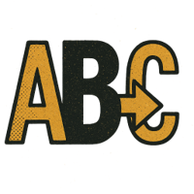


Syntax and Basic Constructs
Literals & Concatenation
Literals match exact characters (e.g., 'cat'). Concatenation joins patterns into sequences (e.g., 'catdog' is 'cat' followed by 'dog'). Example: 'abc' matches 'a', then 'b', then 'c' in order.
Alternation
Use the '|' operator to represent choices. For example, 'cat|dog' matches either 'cat' or 'dog'; 'red|blue|green' matches any of the three colors. Group with parentheses to control scope.
Repetition
Quantifiers express repeated occurrences: '*' for zero or more, '+' for one or more, '?' for zero or one. Example: 'a*' matches '', 'a', 'aa', and so on. Use grouping to target ranges.
Notes:
Key constructs of regex include literals that match exact characters; concatenation to form sequences; alternation representing choice between patterns; and repetition indicating repeated occurrences (using operators like '*', '+', '?'). Mastery of these enables crafting precise token definitions and validation expressions. Understanding precedence and grouping is also essential to correctly interpret complex regex. Image source: AI-generated

Slide 10
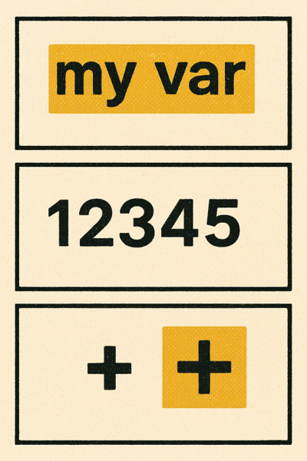
Examples of Regular Expressions
1. Identifiers
Pattern [a-zA-Z_][a-zA-Z0-9_]* matches names like variables and function identifiers.
2. Integer Literals
Pattern [0-9]+ captures sequences of digits representing non-negative integers.
3. Operators
Pattern \+|-|\*|\/ identifies basic arithmetic operators in source text.
Regular expressions succinctly define token patterns so lexical analyzers can reliably tokenize source code.
Notes:
Common token types include identifiers ([a-zA-Z_][a-zA-Z0-9_]*), integer literals ([0-9]+), and operators (\+|-|\*|\/). Regular expressions succinctly define these patterns, enabling lexical analyzers to correctly tokenize the source code. Examples demonstrate how regex translates language specifications into machine-exploitable patterns, emphasizing their practical utility in programming language processing. Image source: AI-generated

Slide 11
Using Regular Expressions in Lexical Analysis
Notes:
Role of Lexical Analyzers (Scanners), Tokenization of Source Code, Practical Examples with C++-Like Tokens

Slide 12
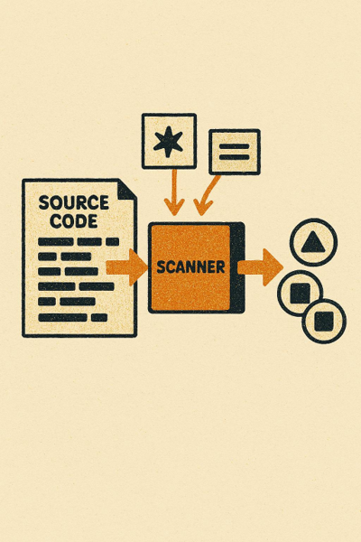
Role of Lexical Analyzers (Scanners)
Purpose and Process
Scans source code to convert character streams into tokens using regular-expression pattern matching.
Isolates meaningful language components while filtering whitespace and comments.
Efficiency and Downstream Impact
Efficient scanning accelerates compilation by reducing work for the parser.
Improves accuracy of later phases by delivering clean, well-formed token streams.
Notes:
Lexical analyzers scan source code to convert character streams into tokens by matching input against regular expression patterns. They act as the first phase of translation, isolating meaningful language components and removing irrelevant elements such as whitespace and comments. Efficient lexical analysis improves compiler speed and accuracy in later parsing phases. Image source: AI-generated

Slide 13


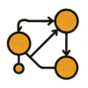

Tokenization of Source Code
Raw Character Input
Source code is read as a continuous stream of characters for initial processing.
Regex Pattern Matching
Regular expressions are applied to identify token boundaries and types.
Finite Automata Execution
Automated tools use finite automata to efficiently scan and segment the input.
Token Stream Output
A structured stream of tokens is produced for downstream syntactic analysis.
Notes:
Tokenization involves segmenting source code into atomic units like keywords, identifiers, constants, and symbols based on regex definitions. Precise tokenization ensures syntactic correctness downstream and supports error diagnostics. Automated tools use finite automata derived from regex for this process, balancing performance with pattern complexity. Image source: AI-generated

Slide 14
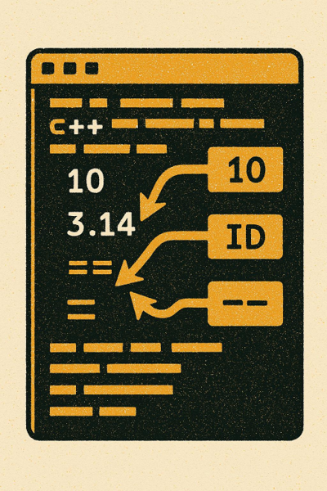
Practical Examples with C++-Like Tokens
Token Categories Overview
Common patterns include integers: [0-9]+, floats: [0-9]*\\.[0-9]+, identifiers: [a-zA-Z_][a-zA-Z0-9_]*, and operators: [+\\-*/]. These form the core of a simple lexer.
Regex Precision in Practice
Order matters: floats should be matched before integers to avoid splitting 3.14 into “3” and “.14”. Whitespace and comments are usually consumed by separate rules.
Keywords vs. Identifiers
After matching an identifier, a keyword table promotes reserved words (e.g., int) to KEYWORD tokens, while similar strings (e.g., integer) remain IDENTIFIERs.
Operator Handling
Use precise classes for single-char operators ([+\\-*/]) and prioritize multi-char tokens (e.g., ++, +=) when extending the grammar to prevent premature matches.
Notes:
In C++-like language tokenization, regular expressions can define integers ([0-9]+), floating-point literals ([0-9]*\.[0-9]+), identifiers ([a-zA-Z_][a-zA-Z0-9_]*), and operators (+, -, *, /). Practical application shows how lexers differentiate between similar patterns, e.g., 'int' as a keyword versus 'integer' as an identifier, highlighting regex precision requirements. Image source: AI-generated

Slide 15
Introduction to EBNF
Notes:
Purpose of EBNF in Grammar Specification, Key EBNF Syntax Elements (Sequences, Choices, Repetition, Optionality), Simple EBNF Examples for Language Constructs

Slide 16
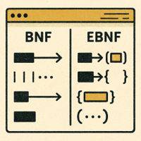
Purpose of EBNF in Grammar Specification
Concision and Readability
Enhanced operators for repetition, optionality, and grouping make grammars concise and easy to scan.
Formal Syntax Definition
Widely used to specify programming language syntax that parser generators can interpret unambiguously.
Maintainability and Clarity
Cleaner notation improves long-term upkeep and understanding of language specifications.
Notes:
EBNF extends traditional BNF by introducing enhanced operators for repetition, optionality, and grouping, enabling concise and readable grammar specifications. It is widely used to formally define programming language syntax, ensuring grammars are unambiguous and easily interpretable by parser generators. EBNF improves maintainability and clarity of language specifications. Image source: AI-generated

Slide 17
Key EBNF Syntax Elements
Sequences
List elements in order to form a sequence. Notation: A B C. Example: digit letter symbol. Use sequences to define fixed ordering of tokens or constructs without separators.
Choices
Represent alternatives with the vertical bar. Notation: A | B. Example: 'yes' | 'no'. Choices express one-of selections among literals, tokens, or rules.
Repetition & Optionality
Repetition uses braces for zero or more: { A }. Example: { digit }. Optionality uses brackets for an optional element: [ A ]. Example: [ sign ]. Combined sample: number = [ sign ] digit { digit }.
Notes:
Sequences are expressed by listing elements in order; choices use '|' to denote alternatives; repetition is indicated by braces { } for zero or more repetitions; optionality uses brackets [ ] to enclose optional elements. These operators simplify grammar writing and improve expressiveness when defining complex language constructs.

Slide 18
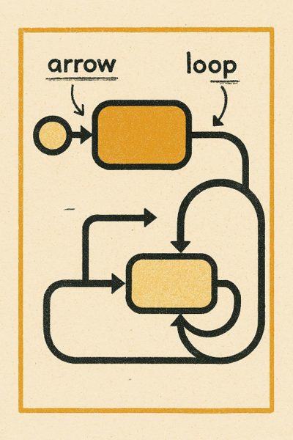
Simple EBNF Examples
Concise patterns that aid parser design
1) Identifier pattern
A letter followed by zero or more letters or digits models typical naming rules used in many languages.
2) Optional semicolon in statements
Sequence includes return, an expression, and an optional terminator—capturing style variations without complicating the grammar.
These examples show how EBNF expresses structure clearly and systematically.
Notes:
Example: Defining an identifier: identifier = letter , { letter | digit } ; Showing optional semicolon: statement = 'return' , expression , [ ';' ] ; Such examples illustrate how EBNF captures real-world language features concisely and systematically, facilitating parser implementation. Image source: AI-generated

Slide 19
Linking Regular Expressions and EBNF in Language Translation
Notes:
How Regular Expressions and EBNF Fit Into the Translation Process, Differences Between Lexical and Syntactic Analysis, Building Simple Grammars: From Tokens (Regex) to Syntax (EBNF)

Slide 20
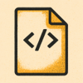



Regex and EBNF in Translation
Raw Code Input
The translation process begins with raw source code, ready for analysis.
Lexical Analysis (Regex)
Regular expressions match character patterns to identify valid tokens such as keywords, identifiers, and literals.
Parsing (EBNF)
EBNF syntax rules arrange tokens into valid language constructs, ensuring structural correctness.
Abstract Syntax Tree
Tokens and constructs are organized into an abstract syntax tree, representing the program's structure for further processing.
Notes:
In translation, regular expressions are primarily used during lexical analysis to identify valid tokens by matching character patterns, serving as the foundation for syntactic structures. EBNF is employed during parsing to define the syntax rules that arrange tokens into valid constructs. Together, they enable modular, stage-wise processing from raw code to abstract syntax trees. Image source: AI-generated

Slide 21

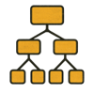


Differences: Lexical vs Syntactic Analysis
Lexical Analysis
Identifies tokens using regular-expression patterns; strips whitespace and comments to prepare input for later stages.
Syntactic Analysis
Parses token sequences against grammar (e.g., EBNF), detects syntax errors, and builds parse trees.
Tools & Techniques
Lexical: regex, scanners. Syntactic: parsers, grammar definitions.
Objectives
Lexical: tokenization, cleaning. Syntactic: structural validation, parse tree construction.
Notes:
Lexical analysis focuses on low-level token identification using patterns (regex), filtering irrelevant data like whitespace/comments. Syntactic analysis parses token sequences to ensure structural conformance to grammar (EBNF), detecting syntax errors and building parse trees. This distinction clarifies responsibilities and techniques in the translation pipeline. Image source: AI-generated

Slide 22
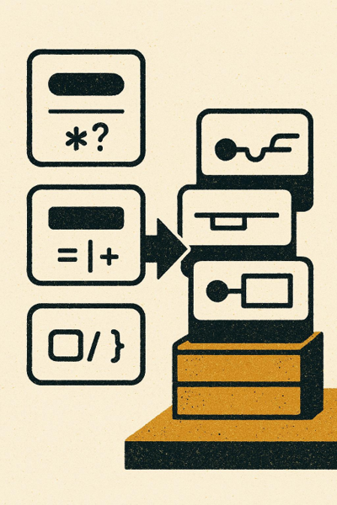
Building Simple Grammars: Tokens to EBNF
Tokens defined by regex capture atomic units, then EBNF composes them into structured rules. This layered method improves modularity and debugging.
1. Define token patterns (regex)
Capture identifiers, numbers, operators, and delimiters with precise, composable expressions.
2. Compose syntax rules (EBNF)
Combine tokens into expressions, statements, and programs using clear, hierarchical constructs.
3. Iterate and debug modularly
Refine tokens and rules independently, ensuring clarity and consistent language semantics.
Notes:
The grammar construction process begins with defining token patterns via regex to identify language atomic units, which are then composed into higher-level syntactic rules using EBNF. This layered approach supports modular grammar design and simplifies debugging. For example, token regexes define identifiers and operators, while EBNF integrates them into expressions and statements. Image source: AI-generated

Slide 23
Conclusion: Bridging Syntax and Semantics in Language Translation
Lexical and Grammar Foundations
Regular expressions handle lexical analysis, while EBNF represents grammar—together structuring how source code becomes meaningful constructs.
Why It Matters
This foundation ensures accurate, efficient translation and prepares you for deeper work in compiler design and language processing.
Notes:
In summary, understanding programming language translation involves grasping the critical roles of regular expressions for lexical analysis and EBNF for grammar representation. Together, they provide a structured approach to converting source code into meaningful constructs, ensuring accurate and efficient translation. This foundational knowledge is essential for further exploration into compiler design and language processing.

